Slide 1
New York- Restaurant Inspection Score/Grade Prediction
`

Slide 2
Problem STATMENT
New York is the one of the biggest cities in the east coast of the United States of America. There are thousands of different kinds of food outlets and restaurants are available. Grading of food market, restaurants are very challenging for the department of public health. Different type of cuisines is available in NY, so grading of restaurant are very difficult. Restaurant management need to complete all the pre-requests for the grade evaluation, this tool will help them to predict their restaurant score prior to application of Restaurant Inspection, this prediction will help restaurant management to target better grade

Slide 3
Data SOURCES
NY OpenData this source provides all the Open Data about NY; Open Data is free public data published by New York City agencies and other partners.
NY CITY Locations this set of data will provide A listing of NYS counties with accompanying Federal Information Processing System (FIPS) and US Postal Service ZIP codes sourced from the NYS GIS Clearinghouse
Restaurant Score - Graded By DOHMS
Yelp Data, with yelp API we are collecting all location details, this will help us to plot the data in NY MAP.
NY Neighborhood data -https://geo.nyu.edu/catalog/nyu_2451_34572
NY Demographics Data – https://en.wikipedia.org/wiki/New_York_City
NY Population Data - https://en.wikipedia.org/wiki/New_York_City
NY Cuisine Data – https://en.wikipedia.org/wiki/Cuisine_of_New_York_City

Slide 4
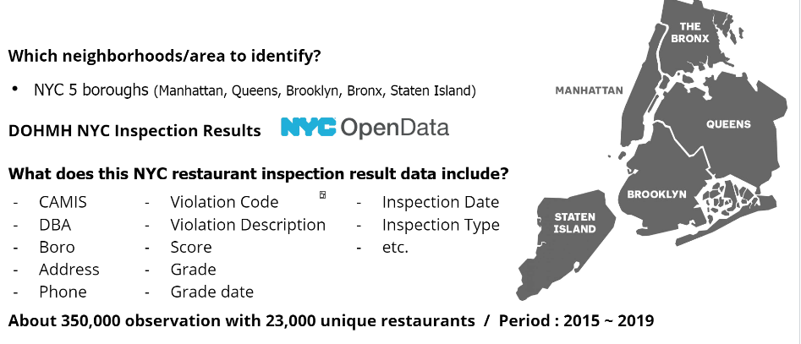
NY NEIGHBORHOODS

Slide 5
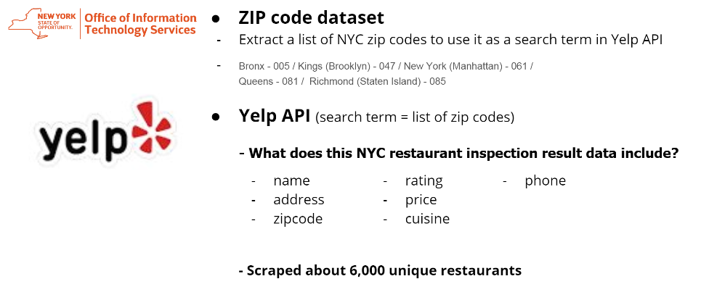
NY Data – YELP Data INTEGERATION

Slide 6
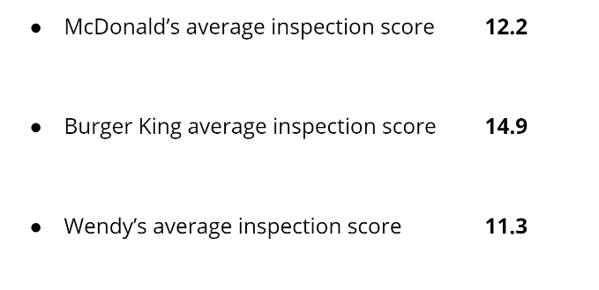
Interesting FACTS found DURING Exploratory DATA ANALYSIS

Slide 7
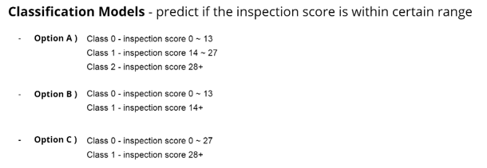
MODELING AND EVALUATION (CLASSIFICATON MODELS)

Slide 8
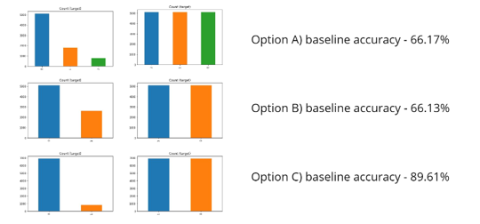
MODELING AND EVALUATION (IMBALANCED CLASS-OVERSAMPLING)

Slide 9
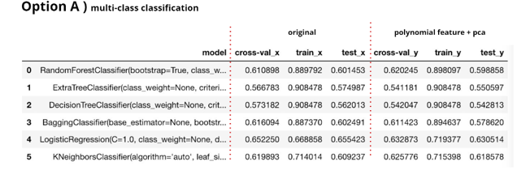
MODELING AND EVALUATION (MULTI CLASSIFICATION)

Slide 10
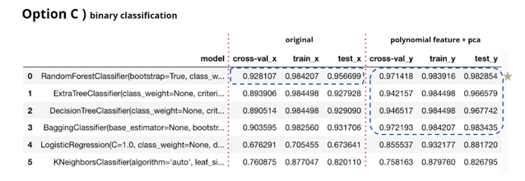
MODELING AND EVALUATION (Binary CLASSIFICATION)

Slide 11
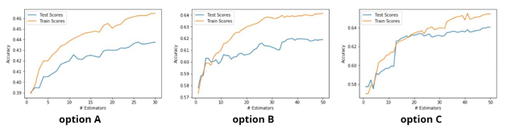
MODELING AND EVALUATION ( ADA-BOOST)

Slide 12
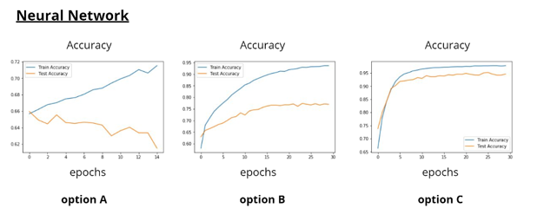
MODELING AND EVALUATION(NEURAL NETWORK)

Slide 13
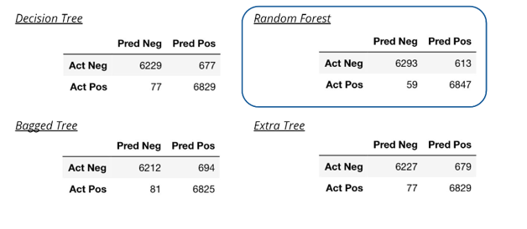
CONFUSION MATRICS oF TREE BASED MODELS

Slide 14
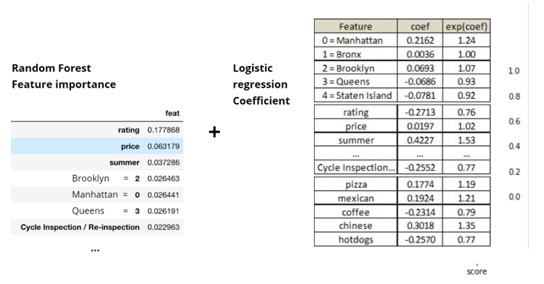
RECCOMMENDATION

Slide 15
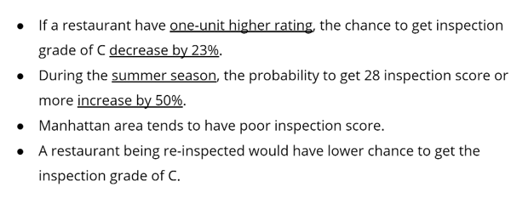
Conclusion and Recommendation

